Slide 1
Computer Graphics Assignment

Slide 2
Game Development
Hoopball Catching

Slide 3
Developed By:
Mr.
Kapeesh Kumar Sharma

Slide 4
DESIGN-
1. Starting the game
2. Playing the game
4. Catch balls
5. Time over
6. Game over

Slide 5
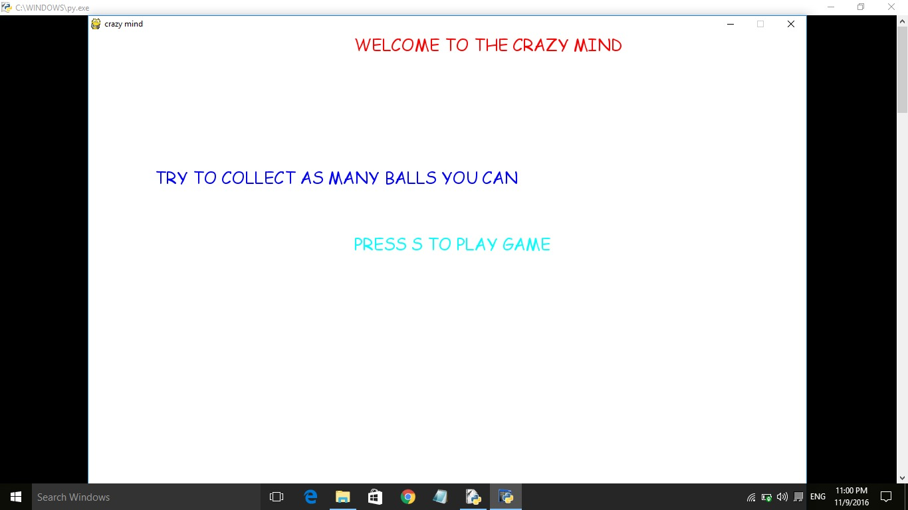

Slide 6
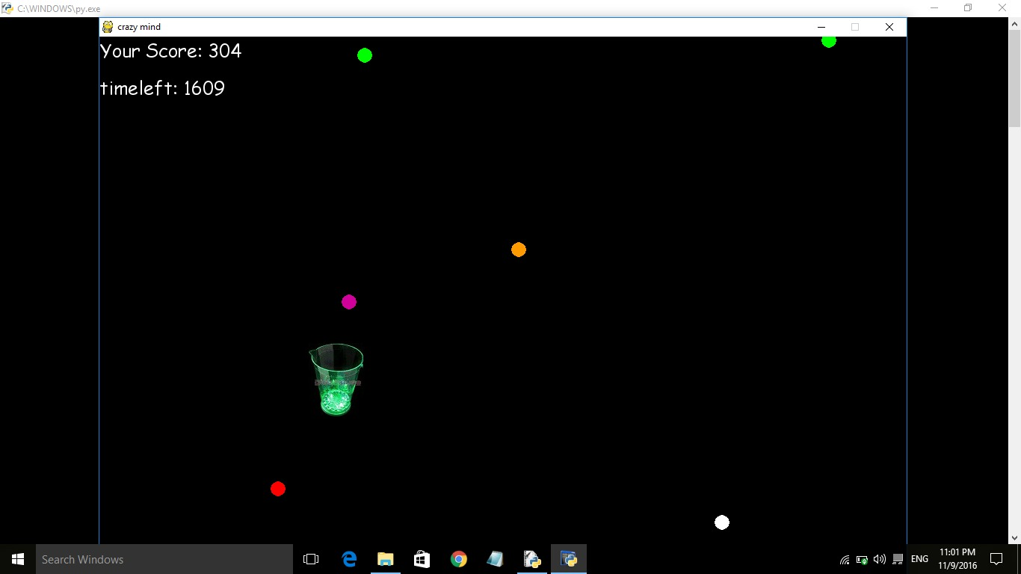

Slide 7
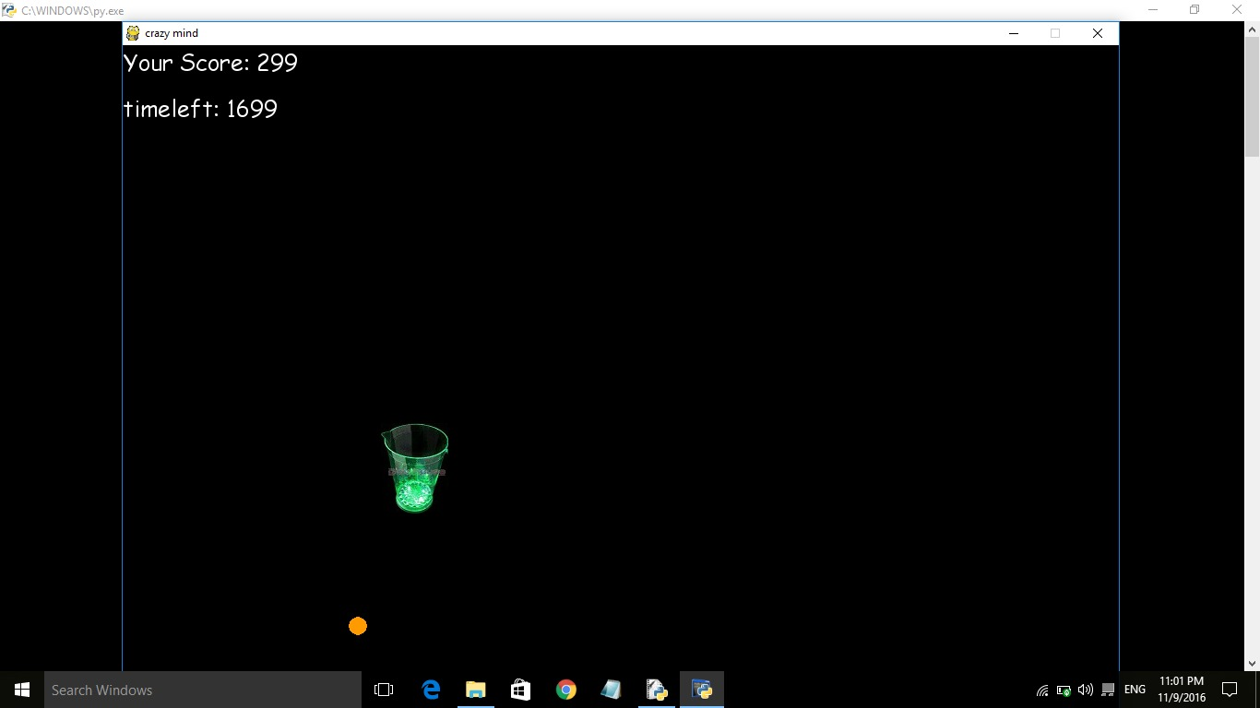

Slide 8
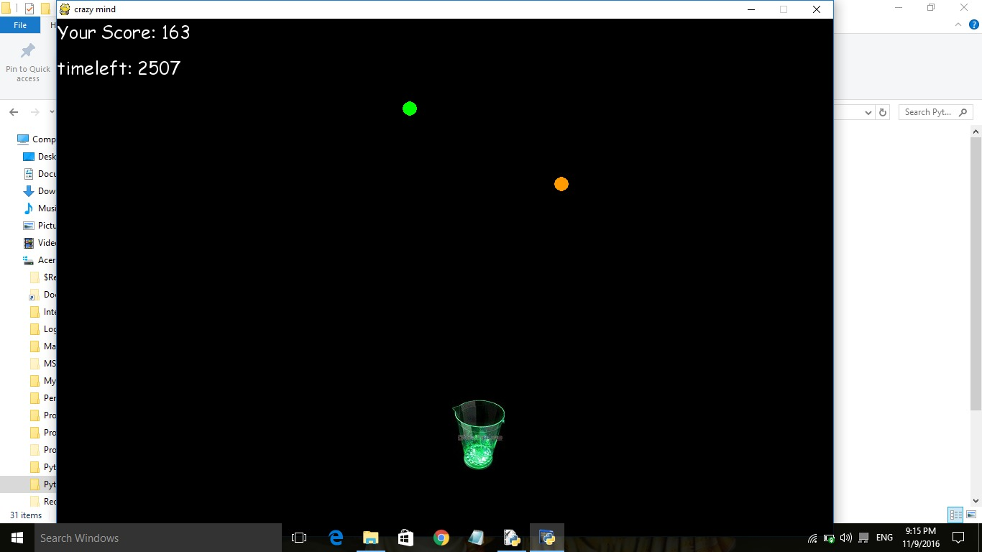

Slide 9
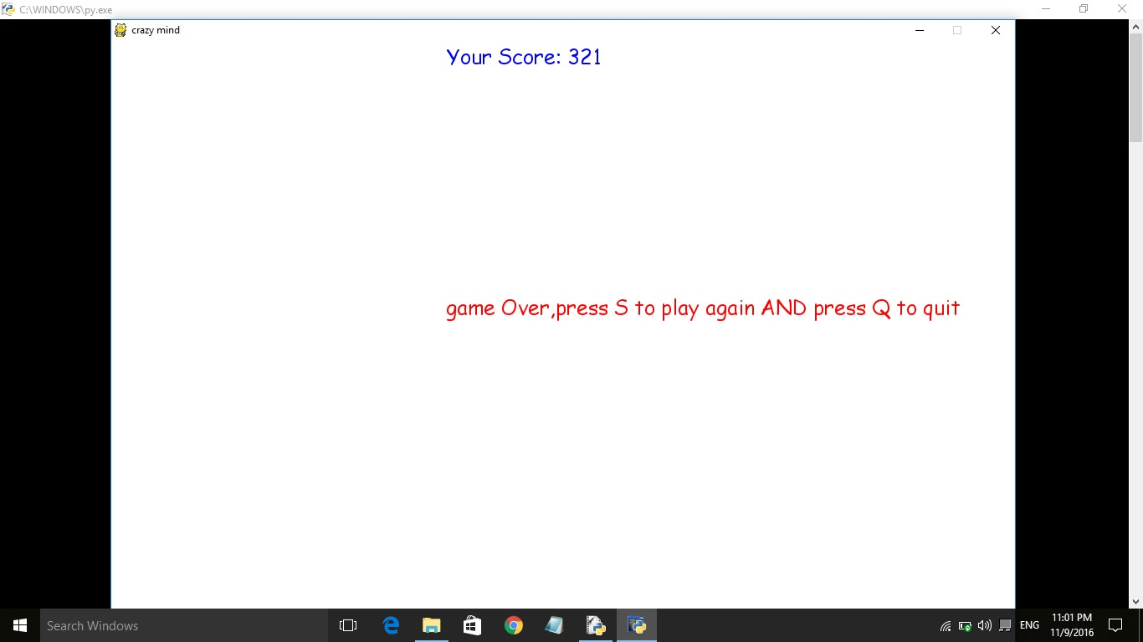

Slide 10
RULES-
Right arrow is used for jug to move right and left arrow is used to move left.
Up arrow is used to move forward and down arrow is used to move downwards.
On holding the buttons jug moves continuously in each direction (upward, downward, right, left).
When time is over (or zero), game over.
Score is depend upon the number of balls you catch.
Each color ball has unique point.

Slide 11
THANK YOU!

